Slide 1
Can Anyone Figure Out Where We’re Going?
Peter L. Slavin, MD
January 21, 2019

Slide 2
We are going to Atlanta

Slide 3
One Approach To Predicting the Future

Slide 4
What We Know: Four Megatrends in Health Care
As the population ages and lives longer demand for health care services will grow
The Federal tax cut will put enormous pressure on the federal budget
The biologic revolution will provide new and innovative treatment options for clinical care
IT will disrupt health care

Slide 5
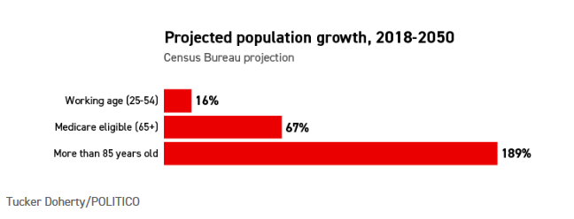
What We Know: As the population ages and lives longer demand for health care services will grow and change
Source: Tucker Doherty/POLITICO
Notes:
Other relevant stats pulled from R. Pollack Slides:
Life expectancy at the advent of Medicare in 1965 (67 males/74 females) vs. now (75 males/80 females)
10,000 baby boomers turning 65 each day. More than half will have multiple chronic conditions (source: GAO Analysis of US Census Bureau Information GAO-17-579T
Implications for:
Volumes
Providers – number and type needed to meet demand
Chronic care/managing multiple chronic conditions
Death and dying – palliative and end of life care
Increased need for social support and coordinated care across providers, care settings and with family/social support
Utilizing tech – using remote monitoring, wearables, etc.
Financial – HC costs, Insurance impact

Slide 6
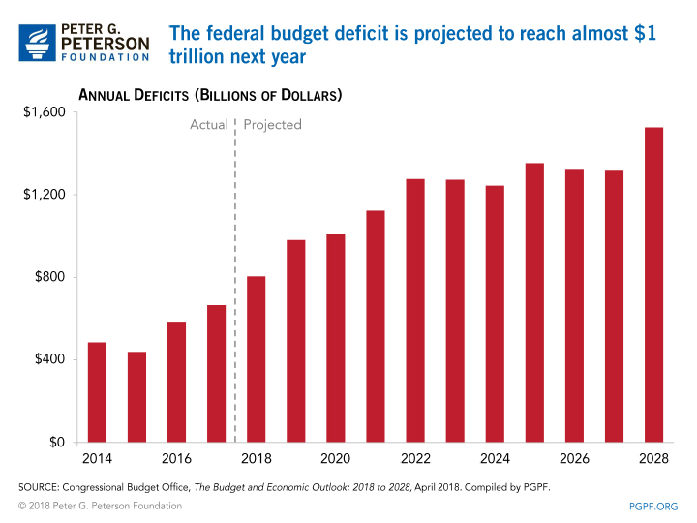
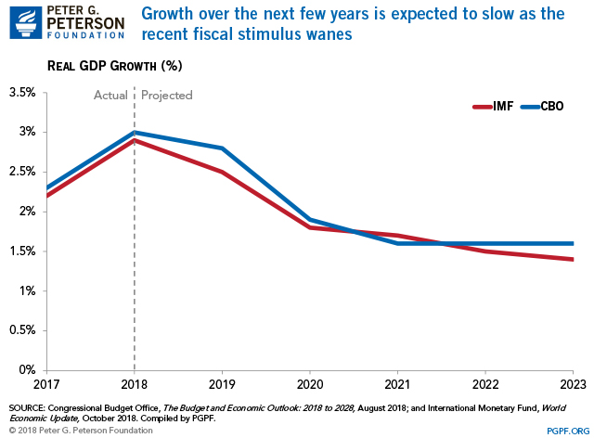
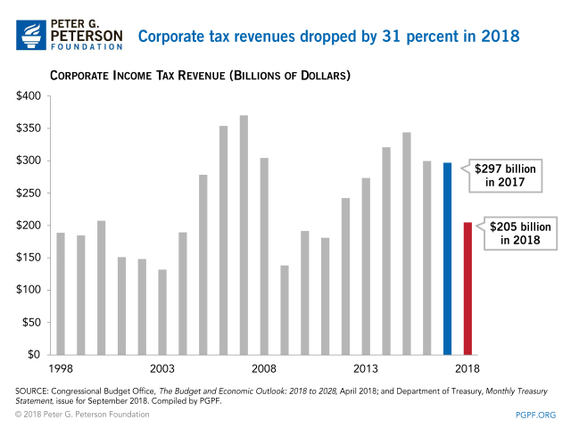
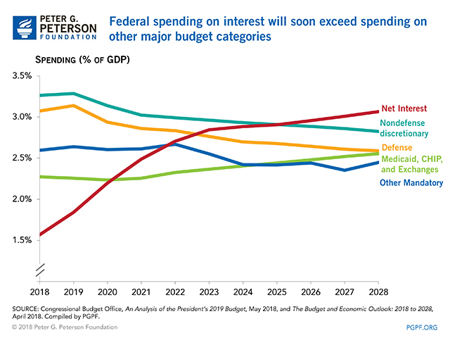
What We Know: The Federal tax cut will put enormous pressure on the federal budget and health care spending

Slide 7
Significant Medicare growth expected, heightening CMS’ focus on containing costs
Impetus: Medicare growth expected to exacerbate existing deficits
HHS Priorities
Moving to Value-Based Care
Lowering Drug Prices
Affordability & Transparency
Opioid Treatment, Regulation, & Enforcement
2010
2030
Est. Medicare Beneficiaries
48M
81M
Average ~4,800 new beneficiaries per day
Funding Deficit as a % of Federal Tax Revenue
-14%
-41%
“There is no turning back to an unsustainable system that pays for procedures rather than value... The only option is to charge forward. For HHS to take bolder action, and for providers and payers to join with us”
– Alex Azar, Secretary of Health and Human Services
Sources: Presentation to Chief Strategy Officer Forum, Health Academy Advisors Oct 2018, “Chasing Healthcare’s Holy Grails, ” JP Morgan Oct 2018

Slide 8
Medicare — timeout needed

Slide 9
The biologic revolution will provide innovative and expensive treatment options for clinical care
A cancer cell (in white) being attacked by two cytotoxic T cells (in red) - NIH
But not without challenges:
Manufacturing & development
Financial
Clinical complexity

Slide 10
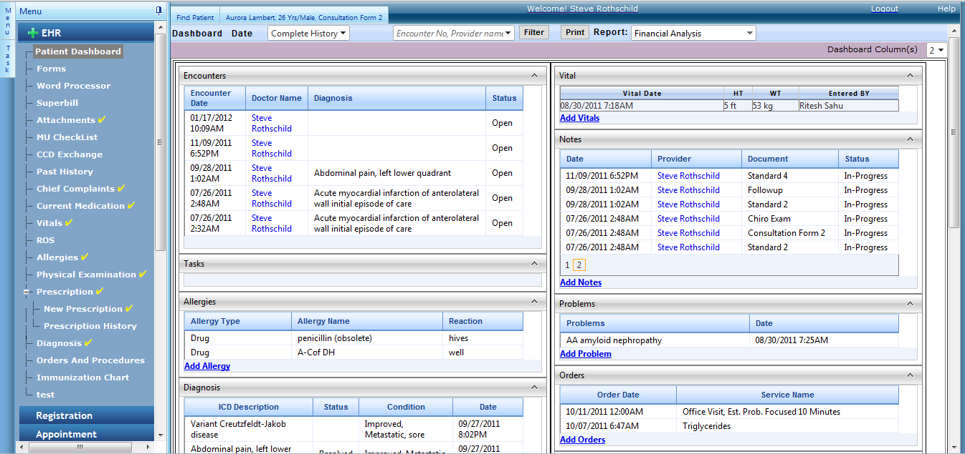
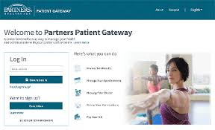
What We Know: IT will disrupt health care
Notes:
What does the crystal ball say?
Data and trends in IT’s strengthening impact in health care (EHRs, telemedicine, big data, AI, wearables, patient facing platforms, etc)
Where does that take us?
More data – can AI help us translate into information to improve quality, decrease costs, etc.
Admin burden – help or hurt?
Tools and platforms for patients – engaging or overwhelming
Accelerated speed and capability will allow us to faster rate of advancement in clinical care…

Slide 11
Tech innovators now leading the U.S economy, with many forging paths into healthcare
Companies on lists in 2008 and 2018
Largest U.S. Companies in 2018 v. 2008
2018 |  |  |  | 2008
Rank | Company | Founded | US$B | Rank | Company | Founded | US$B
1 | Apple | 1976 | 890 | 1 | Exxon | 1870 | 492
2 | Google | 1998 | 768 | 2 | GE | 1892 | 358
3 | Microsoft | 1975 | 680 | 3 | Microsoft | 1975 | 313
4 | Amazon | 1994 | 592 | 4 | AT&T | 1885 | 238
5 | Facebook | 2004 | 545 | 5 | Proctor & Gamble | 1837 | 226
6 | Berkshire | 1955 | 496 | 6 | Berkshire | 1955 | 206
7 | J&J | 1886 | 380 | 7 | Google | 1998 | 198
8 | JPMorgan | 1871 | 375 | 8 | Chevron | 1879 | 192
9 | Exxon | 1870 | 367 | 9 | J&J | 1886 | 192
10 | Bank of America | 1909 | 316 | 10 | Walmart | 1962
Majority focused on disrupting healthcare
Source: Bloomberg, Google, Jan 2018

Slide 12
IT implementation can be rocky

Slide 13
APPENDIX

Slide 14
Market Trends
Overview by Business Planning and Market Development
November 2018

Slide 15
Key Market Trends
Regulators controlling costs by reducing hospital-based reimbursement & advancing value-based care
Accelerating consolidation creating larger provider systems locally, regionally, and nationally
Site of care shift to non-hospital based, outpatient sites continues; tertiary growth driving rising acuity, volume, and length of stay
Disruptor (tech-driven, vertical integrators) create new consumer norms raising the bar for healthcare; analytics/AI unlocking new value

Slide 16
Tech innovators now leading the U.S economy, with many forging paths into healthcare
Companies on lists in 2008 and 2018
Largest U.S. Companies in 2018 v. 2008
2018 |  |  |  | 2008
Rank | Company | Founded | US$B | Rank | Company | Founded | US$B
1 | Apple | 1976 | 890 | 1 | Exxon | 1870 | 492
2 | Google | 1998 | 768 | 2 | GE | 1892 | 358
3 | Microsoft | 1975 | 680 | 3 | Microsoft | 1975 | 313
4 | Amazon | 1994 | 592 | 4 | AT&T | 1885 | 238
5 | Facebook | 2004 | 545 | 5 | Proctor & Gamble | 1837 | 226
6 | Berkshire | 1955 | 496 | 6 | Berkshire | 1955 | 206
7 | J&J | 1886 | 380 | 7 | Google | 1998 | 198
8 | JPMorgan | 1871 | 375 | 8 | Chevron | 1879 | 192
9 | Exxon | 1870 | 367 | 9 | J&J | 1886 | 192
10 | Bank of America | 1909 | 316 | 10 | Walmart | 1962
Majority focused on disrupting healthcare
Source: Bloomberg, Google, Jan 2018
Notes:
As of 10/19/18 market caps (google finance)
Apple $1 trillion
Alphabet (Google) $765B
MSFT 833B
Amazon $860B
Berkshire Hathaway $517B
Facebook $444B

Slide 17
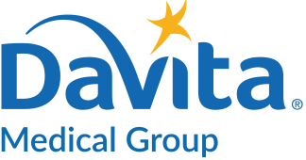
Money flowing into healthcare; new partnerships to disrupt the healthcare industry
Dollars ($B) Invested in U.S. Healthcare
$4.8
$5.4
$5.3
$5.4
$4.1
$3.1
2017Q2
2017Q3
2017Q4
2018Q1
2018Q2
2018Q3
# of Deals
Amount Invested, $B
Major Companies Disrupting Healthcare
Source: PwC Healthcare MoneyTree Report Q3 2018
Notes:
Q2-q3 of 18
• Slight increase in dollars raised this quarter came from the Other Healthcare related industries, having a 27% increase from Q2’18 to Q3’18 $508M to $644M. Primarily driven by 3 mega deals, One Medical Group $220M, One Oncology $220M, and Ajax Health $120M.
Healthcare deals increased in Q3’18 Dollars invested in US Healthcare increased quarter to quarter at $5.3B in Q2’18 to $5.4B in Q3’18 (an all-time record) . • Deal numbers have decreased by 6% from the prior quarter, with 188 deals closing in Q3’18. The average deal value increased from $26.7M in Q2’18 to $28.8M in Q3’18. • Compared to the same quarter in FY’17, dollars invested increased 32% and the number of deals decreased 3% in Q3’18, with a resulting increase in average deal value from $21.3M in Q3’17 to $28.8 in Q3’18.
Humana/Kindred
14 Kindred sites in Massachusetts
Continued Humana investment in home health capabilities (i.e., Humana at Home)
Amazon/Berkshire/JPMorgan
Combines power of consumer- and logistics-centric Amazon, risk- and value-focused Berkshire, and financial engineering of JPMorgan
Long-term management team, headquarters and operational details not yet announced
Questions remain about scalability and replicability of model/product – will need to fight historically locally-based health care model to be successful
Technology-focused solutions may shift focus away from more personal aspects of care (e.g., AI-driven diagnoses/treatment plans)
Target segments of industry are yet to be revealed, but potential to see ripple effects across the board (e.g., pharmacy, provider)
CVS/Aetna
1,100 MinuteClinic locations across 33 states in CVS and Target (~55 MA locations)
Insurance commissions in CA and CO announced plans to scrutinize Aetna practices for granting and denying claims – lawyers say unlikely to affect merger
Seen in part as pre-emptive response to threat of Amazon in pharmacy business
Likely first of many health plan JV/mergers with pharmacy organizations, highlighting need to go beyond traditional med. mgmt.
Impact to our geography may be smaller given Aetna’s low market share (4% of total MA commercial enrollment), and consumers’ preference for PCPs in market
Optum/Da Vita
Medical staff >2K at DaVita Medical would join ~30K doctors working / affiliated with Optum
Davita Medical group serves ~1.7M patients/year in ~300 clinics with primary and specialty care; operates 35 urgent care centers and 6 outpatient surgery centers
Optum has ability to provide care directly to patients through its network of surgical centers, urgent-care centers (~250 in the US; 2 in MA, with another to come) and HouseCalls program
UHG’s acquisition of DaVita Medical Group shows intent to direct patients from high cost hospital settings to lower-cost OP facilities
Optum’s growing presence in Massachusetts, including Reliant Medical Group acquisition, may position themselves as competitors
Will Optum strengthen MA presence further?
Walmart / Humana
Would allow Walmart to leverage Humana’s strength in Medicare Advantage, driving business to their pharmacy and retail clinics
With 1.5M workers, may allow Walmart to lower operating costs related to employee insurance

Slide 18
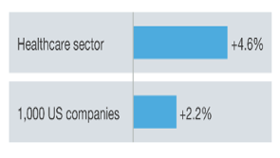
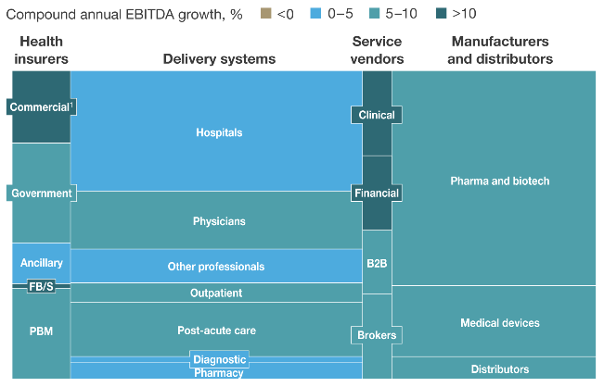
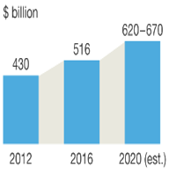
Healthcare continues to grow at a faster clip than overall industry; largely in the health services and insurers sectors
Historical US Healthcare Growth
Projected US Healthcare Growth
Compound annual EBITDA Growth, 2012-16
Projected Changes in EBITDA across US Healthcare Industry, 2020
US Healthcare Sector EBITDA, 2012-2020
Higher future projected growth
(5-7% CAGR growth)
Modest growth in the delivery sector, with greater growth in adjacent sectors (i.e. health insurers and service vendors)
Source: McKinsey “The Future Healthcare: Finding Opportunities Lie Beneath Uncertainty,” Jan 2018

Slide 19
Cost pressures, technology, and sociological shifts are driving disruption in the healthcare landscape
$
Unabated Pressure to Control Healthcare Costs
Data and Technology Platform Advances
Sociological Shifts
Mounting regulatory uncertainty - new legislations to curb healthcare costs
High costs a competitive disadvantage for employers in a global economy
Big data , AI-driven analytics to predict patient risk
Cloud-based, open platforms enable scale, portability, and collaboration among people, data, and transactions
Embedded seamless connectivity (“Internet of Things”) to ‘smart’ devices and the environment
‘Time poverty’ prompts consumer demands for access and convenience
Friction-less consumer services increase drive expectations for curated, seamless services
Hyper-personalization of health data and consumption of goods and services
Sources of advice and trust shift to crowd from authority
Adapted from “Industry Interrupted Report”, Oliver Wyman Jan 2018

Slide 20
Significant Medicare growth expected, heightening CMS’ focus on containing costs
Impetus: Medicare growth expected to exacerbate existing deficits
HHS Priorities
Moving to Value-Based Care
Lowering Drug Prices
Affordability & Transparency
Opioid Treatment, Regulation, & Enforcement
2010
2030
Est. Medicare Beneficiaries
48M
81M
Average ~4,800 new beneficiaries per day
Funding Deficit as a % of Federal Tax Revenue
-14%
-41%
“There is no turning back to an unsustainable system that pays for procedures rather than value... The only option is to charge forward. For HHS to take bolder action, and for providers and payers to join with us”
– Alex Azar, Secretary of Health and Human Services
Sources: Presentation to Chief Strategy Officer Forum, Health Academy Advisors Oct 2018, “Chasing Healthcare’s Holy Grails, ” JP Morgan Oct 2018

Slide 21
CMS policies address a broad array of levers to contain cost
Simplification / Regulatory Flexibility
Site of Care
Alternative Payment Models (APMs)
Reduction in Drug Reimbursement
E&M payment compression
E&M codes from 5 to 3 levels
Effective 2021
Expanded coverage of telehealth services and loosening of billing restrictions
Virtual check-ins
Remote evaluation
Etc.
Expansion of site neutral policy
Over 2 years, E&M payments at grandfathered provider based departments and MD offices will be the same
CMS removing services off IP only list
MACRA and incentivizing APMs
Revisiting mandatory bundles
Bipartisan support of Medicare Advantage
International Pricing Index
Reduce 340B drug payments (average selling price -22.5%)
Reduced payment for new-to-market drugs
Consumerism
To increase price transparency, CMS requiring hospitals to post standard charges online beginning 1/1/2019
Notes:
Reduced Reimbursement:
Site Neutral Payments -In November, CMS finalized a proposal to reduce Medicare payments for clinic visits at off-campus hospital clinics to 40 percent of the OPPS rate be phased in over two years and beginning CY19
The clinic visit is the most common service billed under the OPPS, and CMS estimates the payment proposal would save the Medicare program and Medicare recipients a combined $760 million in 2019. (Beckers)
This change is projected to reduce OPPS payments by 1.2 percent, which would largely offset the 1.25 percent payment rate increase under the proposed rule. (Beckers)
PHS threat of -$9.3M in CY19 (Gov. Affairs)
340B Program- In addition to site neutral payment changes, CMS finalized a proposal to increase the number of hospitals and other facilities affected by the nearly 30% payment cuts for physician-administered drugs;
PHS threat may affect BWH’s new off-campus PBDs
Medicare Physician Payment Cuts- Medicare will pay doctors 3 percent less in 2019 than they receive now for administering drugs in Medicare Part B that have just entered the US market (for at least the first three months)
Bipartisan support of Medicare Advantage
Flexible and innovative benefits including in-home and care giver support services
Lower premiums in 2019
Both factors helping to drive enrollment growth
Extended site neutral payments
Further eroding protections for grandfathered sites
Expansion of covered telehealth services
Virtual check-ins, remote evaluation, and brief communication check-ins via phone or other devices
allowing private-sector vendors to negotiate prices for drugs and compete for physician practice and hospital business
2. Move to VBC:
As CMS continues to exert downward pressure on healthcare costs, changes to the risk model are inevitable.
Moving from the maximum incentive FFS Prospective Payment Models to Health Risk Payment Models (Global Capitation) are the future
P4P for Hospitals, SNFs, and Docs → Medicare Episode incentives → Medicare Shared Savings (ACO’s) → Medicare Capitation (MA part C)
Medicare Advantage
MA enrollment is projected to increase to an from the current enrollment of 20.2 million to 22.6 million in 2019, an 11.5% increase compared to 2018.
Medicare Advantage
An expected 36% of Medicare beneficiaries are expected to enroll in MA plans in 2019 (an all time high)
MA premiums in 2019 is estimated to decrease by 6% to $28.00, from an average of $29.81 in 2018.
MA will be offering approx. 600 more plans in 2019 (from 3,100 to 3,700)
https://www.cms.gov
Total number of Medicare Beneficiaries are expected to increase from ~47.7 million to ~81 million by 2030
Annual funding Deficit is expected to increase from ~311 million to ~912 million by 2030
Funding Deficit as % of Total Federal Tax Revenues is expected to jump from ~14% to ~41% by 2030
Funding Deficit as % of Total Federal Budget is expected to jump from ~9% to ~26% by 2030
Telehealth Takeaways
Less treatment time required to qualify for reimbursement. CPT 99091 requires at least 30 minutes per 30-day period, whereas CPT 994X9 requires only 20 minutes per calendar month. The new code is much easier to track on a monthly basis, and requires 33 percent less time.
Separate payment for initial set-up and patient education. CPT 99091 does not offer additional reimbursement for the time spent setting up the RPM equipment or educating the patient on its use. The new codes offer separate reimbursement for the work associated with onboarding a new patient, setting up the RPM equipment and training the patient on same. This is a very helpful move to further incentivize providers to start using these technologies with their patients. In addition, this separate payment is different from how Medicare reimburses Durable Medical Equipment (DME) suppliers (e.g., CPAP, oxygen, etc.). CMS requires the DME supplier to set up the equipment at the patient’s home and educate the patient on how to use the equipment, but does not offer separate payment for that work.
Clinical staff allowed. CPT 99091 is limited only to “physicians and qualified health care professionals” and does not expressly allow the RPM service to be delivered by clinical staff (e.g., RNs, medical assistants, etc.). This means the physician or qualified health care professional must perform the full 30 minutes per 30-day period, which is a lot of time for these highly trained professionals. For some providers, this is too resource-intensive to justify the $58.68 per month reimbursement rate. The new code allows RPM services to be performed by clinical staff.
Changes to TKR requirements
In the 2018 Outpatient Prospective Payment System Final Rule, CMS made an unprecedented change by removing total knee replacement (TKR) from the Medicare inpatient-only list.
If a TKR is performed as outpatient rather than inpatient, a community hospital with little or no medical education would see a decline in payment of 25 percent, while a academic medical center would see declines up to 60 percent.
The first fact to understand in this analysis is that CMS still requires that all TKRs performed on fee-for-service Medicare beneficiaries be performed in a hospital. They are not (yet) allowing patients to have TKRs performed in ambulatory surgery centers (ASCs). That means we are solely debating the difference between an inpatient TKR in a hospital and an outpatient TKR in a hospital.

Slide 22
State Levers to Contain Costs…
Per Capital Total Health Care Expenditures (THCE) Growth
Healthcare Reform
It is highly likely that Massachusetts legislators will revisit reform in January 2019
After the 2018 session failed to reconcile the two bills from the Senate and the House, policymakers are likely to continue focus on:
Provider price variation
Financial support to struggling community hospitals
4.2%
Prior Benchmark = 3.6%
2018 Benchmark = 3.1%
Significant Reforms to DoN Approval Process in 2017
2012-13
2013-14
2014-15
2015-16
2016-17*
2018
DoN application for new/expanded services now must address: cost containment, access to care, health equity, social determinants of health, etc.
Proposed amendment in Fall 2018 to aggregate projects by licensed site for main campus and satellite sites could have material impact on capital planning and application submission processes
Massachusetts’ THCE growth has been below the state benchmark for the past two years
*Data is preliminary.
Source: 2018 CHIA Annual Report
Notes:
Healthcare reform:
At the state level, the House and Senate failed to advance major health care legislation this year, as the two branches were unable to forge a compromise before the formal legislative session ended on July 31st. However, we expect that they will revisit this topic when the next legislative session begins in January, 2019. Policymakers are likely to continue to focus on provider price variation and providing financial support to struggling community hospitals. Source: PHS Government Affairs
The 2018 session failed to reconcile the Senate and House bills. The focus of these bills included a focus on trying to find a way to financially stabilize community hospitals in the short term with assessments on insurers and large hospitals.
House Speaker Robert DeLeo has commented that upcoming negotiations would include a look at MassHealth reform Source: Boston Business Journal 10/16/2018
DPH Approval for Service or Site Expansion (Determination of Need):
Determination of Need (DoN) was created to –
Reduce/control health care costs by constraining supply in a planned manner;
Improve quality of care provided by assuring providers have a high value of services; and
Equalize access to care by promoting a geographic allocation of resources.
2018 Proposed changes (to be finalized December, at the earliest):
Delay in DoN review of projects: Proposed new definition of filing date that will impact/extend four month review clock
New rules to require ‘Mega’ applications: Proposed requirement for licensed facilities to file a single application for all projects (including those at the main campus and any satellites) that meet DoN thresholds, when consolidated over the course of the federal fiscal year. This concept would replace the current aggregation policy and the 18-month rolling clock.
Threats to PHS:
administrative burden
Consolidated application will delay ability to file and move projects forward;
DPH attempting to lengthen review process; and
Retroactive application of consolidated filing requirement provides no notice to allow providers to plan to meet requirement, ultimately delaying projects in 2019 (construction jobs access)
Proposed changes have the potential to slow down hospital construction projects across the state.
The new proposed DoN changes have the potential to inhibit a hospital’s ability to go to the bond market.

Slide 23
Hospital margins under pressure as expenses outpace revenue growth and commercial enrollment flattens
U.S. Non-Profit Hospitals: Median Revenue and Expense Growth, 2009-2017
Total U.S. Health Insurance Enrollment:
Commercial vs. Government Share
Government
5.7%
6.1%
Commercial
Revenue growth
Expense growth
’09
’10
’11
’12
’13
’14
’15
’16
’17
’08
’09
’10
’11
’12
’13
’14
’15
’16
’17
The 2017 median operating margin among not-for-profit hospitals is 1.6%, which is an all-time low
With commercial insurance enrollment declining, hospitals must rethink their strategy
Facing increased financial pressures, many hospitals are seeking to merge or affiliate
Sources: State of the Union, Advisory Board, Oct 2018 – revenue and expense growth chart based on FY 2017 audited financial statements of 303 freestanding hospitals, single-state health systems, and multistate health care systems; U.S. Census, Health Insurance Coverage in the United States, 2008-2017; AHA Annual Survey & TrendWatch Chartbook 2018;
Note: Overall US Health Insurance Enrollment reflects the sum of Private (employer-based, direct-purchase, and TRICARE), Medicaid, and Medicare; Gov’t Payer excludes VA Care

Slide 24
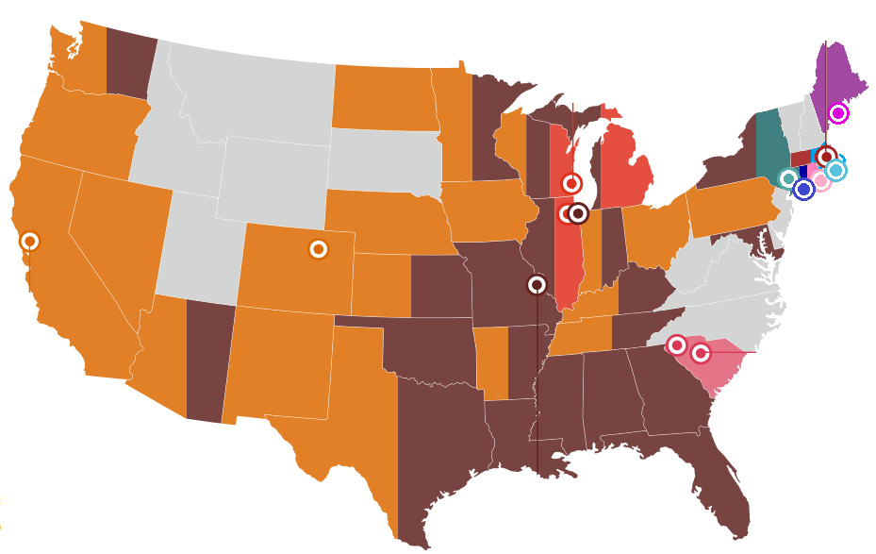
M&A volume and transaction size increasing as hospitals seek financial stability & market share growth
Total Number of Hospitals Acquired
Recent/Proposed “Mega-Mergers” with Combined Revenue
$5B
Beth Israel Deaconess / Lahey Health
$15B
Partners / Care New England
$11B
Advocate Health Care / Aurora Health Care
2x
Proposed
Proposed
Completed (Apr 2018)
$3B
Maine Med Ctr /
6 hospitals
Proposed
$3B
Hartford / St. Vincent’s
2006-2009
2010-2013
2014-2017
Aggregate Revenue of M&A Targets
Proposed
$4B
Yale New-Haven / Milford Hospital
$28 B
Dignity Health / Catholic Health Initiatives
Proposed
3x
Proposed
$11B
Presence Health / Ascension
$2B
Health Quest / W. Conn Health
$78B
$90B
$28B
$4B
Greenville Health / Palmetto Health
Completed (Mar 2018)
Proposed
2006-2009
2010-2013
2014-2017
Proposed
Sources: Kaufman Hall & Associates report: “2017 in Review: The Year M&A Shook the Healthcare Landscape”; McKinsey & Co. report: “Provider scale strategies: A 2018 update on the evolving landscape”, April 2018; PwC report: “Medical cost trend: Behind the numbers 2019”, June 2018.
Note: Number of hospital beds for Partners & Care New England includes bassinets
Notes:
Historically, private equity firms have stayed away from the healthcare – but this is no longer true.
Several big name PE firms – including KKR, Summit Partners, and Cerberus – have been very active in acquiring hospitals, health systems, and physician groups.
KKR purchased Envision Healthcare $9.9 billion in June 2018
Envision is the nation's largest physician staffing firm with 25,000 physicians and other medical practitioners who staff hospital departments, including the emergency room, radiology, anesthesiology and neonatology
KKR acquired Covenant Surgical Partners in Aug 2017 for $195 million
Covenant is an operator of ambulatory surgery centers and physician practices with 37 facilities located across 17 states
Steward Health Care (backed by Cerberus Capital Management) acquired IASIS Healthcare in 2017 for $2 billion
IASIS owns or leases 17 acute care hospital facilities and one behavioral health hospital facility with a total of 3,581 licensed beds
Summit Partners bought Sound Inpatient Physicians Holdings (Jointly with Optum) for $2.15 billion in June 2018
Sound Physicians is a physician staffing company with more than 2,000 hospitalist, intensivist, emergency medicine and transitional care providers
Summit Partners invested $250 million (not a controlling interest) in 2016 in DuPage Medical Group
DuPage is the largest independent physician group in Illinois.
Magnitude of mega-mergers:
Dignity Health / Catholic Health Initiatives – combined: 22,200 hospital beds
Advocate Health Care / Aurora Health Care – combined 4.2 million patients
Beth Israel Deaconess / Lahey Health – combined 197 care locations
Partners / Care New England – combined: 4,700 hospital beds
Maine Medical Center / 6 hospitals – combined 19,000 employees
Hartford / St. Vincent’s – combined 7 acute care hospitals
Yale New-Haven / Milford Hospital – combined 2,800 beds
Health Quest / W. Conn Health – combined 1.5 million patients
Greenville Health / Palmetto Health – combined 22 hospitals
Presence Health / Ascension – combined 2,750 care sites

Slide 25
Proposed BI/Lahey merger will create a serious competitor and change competitive dynamics in MA
Eastern MA Inpatient Market Share, FY16
Massachusetts Physician Counts by System (2017)
5,197
PCPs
4,233
Specialists
∆ % Market Share pts, 2014-2016
2,380
1,595
897
357
EMA Market
Partners
BI / Lahey
Steward
Wellforce
Atrius
BID
Share (%) of Commercial Adult PCP Visits (2015)¹
29.1%
23% +1.0%
Proposed BID/Lahey
Merger
BI / Lahey
Partners
Atrius
Steward
Wellforce
Umass
All Others
BID
Sources: Sources: CHIA Acute Hospital Case Mix Data FY15 – FY17; excludes Normal Newborns (MSDRG 795) and Shriners Hospital Includes major hospital systems of PHS (BWFH, BWH, MGH, NSMC, NWH), BID (BIDMC, BID-Milton, BID-Needham, BID-Plymouth); Lahey Health (Lahey, Northeast, Winchester); Steward (Carney, Good Sam, Holy Family, Morton, Nashoba, Norwood, Quincy, St. Anne’s, St. E’s); Wellforce (Lowell General, MelroseWakefield, Lawrence Memorial, Tufts)
Notes: 1) Share (%) of commercial adult PCP visits by system is for three largest commercial payers;

Slide 26
Growth forecasted for both tertiary and outpatient services; market responds with JVs in lower acuity sector
Volume Forecast for Eastern Mass, 2017-2027
Shields Joint Ventures Expand to ASCs
Inpatient
Tertiary
+
Discharges (000s)
Discharges (000s)
+9.9%
+
Announced Jan 2018
17,500 sqft
$16 million partnership
+0.9%
Announced Oct 2018
Details TBD
600
512K
509K
516K
40
34K
36K
500
35
32K
400
30
25
300
20
200
15
Shrewsbury
Medford
100
10
Natick
5
Westwood / Dedham
0
2017
2022
2027
0
2017
2022
2027
Outpatient
+
+
Visits (Millions)
Opened May 2018
35,000 sqft
9 operating rooms
$31 million partnership
+19.0%
100
86M
80
72M
79M
+
60
Opened Sept 2013
33,000 sqft
8 operating rooms
40
20
Shields already provides MRI services at 40+ facilities in MA through hospital joint ventures
0
2017
2022
2027
Joint ventures and partnerships enable organizations to fast-track their ambulatory expansion
Sources: “Outpatient Statistical Snapshot”, Avanza Healthcare Strategies, 2018; Sg2 Analysis, 2018; “Hallmark Health looks to build new ambulatory surgery center in Medford’s Lawrence Memorial Hospital”, Wicked Local Medford, Jan 2018; “UMass-Reliant-Shields to open $31M Shrewsbury surgical center”, Worcester Business Journal, May 2018; “Reliant Medical Group and Shields Health Care partner to create proposal for new ASC”, Becker’s ASC Review, October 2018; “New England Baptist, Shields sell Dedham building for $34M”, Boston Business Journal, Oct 2016

Slide 27
As consumers increasingly look for a frictionless experience, new care models are emerging and redefining the patient care
Demands for friction-less experience with ease of access and convenience
Types of Disruptions
Illustrative Examples
PHS Examples
Enhancing patient access
MD On-Demand
Telehealth platforms
“Find a Doctor” Tools
Doctor House Call
Telehealth Service
Urgent Care
Alternatives to Traditional Primary Care
Employers investing in on-site employee clinics
Retail Clinics
Technology-enabled primary care
Ambulatory 2.0
Dedicated Patient Advocate
Urgent Care
Access to health records
Ensuring a Frictionless Experience
Communication platform
On-Demand Healthcare Transportation
Patient Connectivity
“Facebook for patients”
Partnership to provide transportation
Notes:
Implications for PHS:
Patient outcome and quality of care will remain integral to patient experience; however, increasing focus on ability to provide a frictionless experience
New entrants will continue to challenge and redefine the evolving health care experience
https://health.oliverwyman.com/2018/01/healthcare_is_ripef.html
Consumers are beginning to expect their MDs and health plans to offer the same convenience and personalization as other service industries
https://khn.org/news/spurred-by-convenience-millennials-often-spurn-the-family-doctor-model/
Speed and convenience is valued higher
digital tools that enable people to communicate with their doctors and make appointments via their smartphones
Same-day appointments
Walk-in Clinics
The above trends are drivers for ambulatory, urgent care and walk-in clinics
Generational shift in PCP enrollment supports this:
45 percent of 18- to 29-year-olds had no primary care provider
compared with 28 percent of those 30 to 49
18 percent of those 50 to 64
12 percent age 65 and older
https://khn.org/news/spurred-by-convenience-millennials-often-spurn-the-family-doctor-model/
Current state of Telehealth – consumer vs. provider
https://www2.deloitte.com/insights/us/en/multimedia/infographics/virtual-health-care-survey-infographic.html?id=us:2pm:3ta:di4630:awa:lshc:091718:ad1:bombora:desktop:businessinsider
Digital Assistance – companies like Amazon, google, Apple (this doesn’t seem to fit)
https://intel.sg2.com/-/media/Webinar_PDFs/2018/Sg2-Webinar_Disrupters-to-Watch-in-2018.ashx
Increases provider/patient ratio
patients report vital sign data
Provide reminders for medication and exercise
Facilitate patients to call for caregiver help and coordinate transportation
Use hardware to facilitate virtual visits
Reduction in loneliness
Elimination of redundancy for caregivers and improvement in caregiver productivity
Daily medical reports
Patient facing tasks (appointment scheduling)
Physician facing tasks (EHR input)
Administrative: streamline claims processing, allowing for claims to be submitted faster and more accurately, lowering reimbursement denials, delays and appeals
Pricing low, barriers to adoption are low
Large employers are investing in on-site clinics to promote ease of access (but also to implement employee-based population health programs – will be highlighted in the Hyperlocalization slide)
Apple Employee Clinics (AC Wellness) – Primary care clinics with wellness professionals (NPs, nutritionists and exercise specialist)
https://www.cnbc.com/2018/08/02/apples-first-hires-for-its-clinics-are-delivering-care-and-not-just-.html
Amazon is reportedly launching a primary care clinic for a small number of employees at its headquarters in Seattle
https://www.beckershospitalreview.com/finance/amazon-apple-join-growing-list-of-companies-opening-on-site-clinics-for-employees.html
Microsoft – employee health plan called Health Connect Plan: “partnering with insurer Premera Blue Cross and service provider Eastside Health Network to create the Health Connect Plan”
https://www.hrdive.com/news/microsofts-new-health-plan-is-focused-on-a-better-patient-experience/540573/
Tesla - employee-exclusive health clinics; staffed by physicians and nurses who offer "immediate first-class healthcare,"
https://www.beckershospitalreview.com/hospital-management-administration/tesla-invests-in-health-clinic-for-employees.html
New Types of Care Models: Alternative Entry to Simple Care
OneMedical - technology-enabled primary care
https://www.onemedical.com/about/
American Well – telehealth platform for providers
https://www.americanwell.com/
CVS Minute Clinic
https://www.cvs.com/minuteclinic
Is target part of the minute clinic business venture?
CVS Health’s membership program “CarePass”
https://www.consumeraffairs.com/news/cvs-launches-membership-program-pilot-103118.html
provides discounts, free delivery on most medications and "eligible purchases" from the company's website, and $10 monthly to spend on most items in-store
Pilotted in 350 locations in the Boston area.
Subscribers pay $5 monthly or $48 for an annual subscription
Consumers who subscribe also get access to a pharmacist helpline and a 20 percent discount on all CVS-branded products.
New Entrants into Healthcare: Retail Front Door to Healthcare
CVS / Aetna
Walmart/Humana
Amazon/Pillback/Alexa

Slide 28
Consumers are beginning to expect healthcare to offer the same personalization as other service industries
Demand for personalization of services from providers and health plans
Types of Disruptions
Illustrative Examples
PHS Examples
Provider Solutions for Individualized Care
MGH awarded grant to champion NIH program
Real-time admission and discharge notifications
Gene Therapy
Pioneers
Bioprinting
Precision
Medicine
Launched in 2001
Member Navigation and Engagement
Member Navigation Platform
Member Navigation
Member Engagement
“Amazon Prime”-like
Services
Predictive
Analytics
Machine Learning
Patient Risk Analytics
Big Data
AI Partnership
Notes:
Implications for PHS:
Patient outcome and quality of care will remain integral to patient experience; however, increasing focus on ability to provide a personalized experience
New entrants will continue to challenge and redefine the evolving health care experience
Increased interest in healthcare
Big Tech Players
Google:
Announced in the Spring that they will focus on healthcare in the next few years
Apple:
https://intel.sg2.com/-/media/Webinar_PDFs/2018/Sg2-Webinar_Disrupters-to-Watch-in-2018.ashx )
Ecosystem development
EHRs
Augmented reality
Alphabet
https://intel.sg2.com/-/media/Webinar_PDFs/2018/Sg2-Webinar_Disrupters-to-Watch-in-2018.ashx
Enhancements via Product Portfolio and Partnerships
Amazon:
Partnership with Merck to develop digital voice-enabled solutions for people living with chronic diseases
Recent entry into OTC and acquisition of medical device licenses
Source: https://health.oliverwyman.com/2017/12/infographic_amazon.html
Amazon offers a platform and big data
https://intel.sg2.com/-/media/Webinar_PDFs/2018/Sg2-Webinar_Disrupters-to-Watch-in-2018.ashx
Consumer behavior and purchasing habits
Echo platform and Alexa digital assistance
Deep expertise in distribution infrastructure
Brick and Morter access points through Whole Foods acquisition
Big data and cloud computing services
Amazon Scribe for transcription services
Amazon Echo for inexpensive telemedicine applications platform
Leverage supply chain distribution capabilities for shipping durable goods
PHR platform development
Cerner/Amazon deal for HealtheIntent
Technological Advancements
Healthcare AI
https://newsroom.clevelandclinic.org/2018/10/24/cleveland-clinic-unveils-top-10-medical-innovations-for-2019/
applications in decision support, image analysis and patient triage
helping physicians make smarter decisions at the point of care, improving the ease and accuracy of viewing patient scans and reducing physician burnout
Telehealth
https://www2.deloitte.com/insights/us/en/multimedia/infographics/virtual-health-care-survey-infographic.html?id=us:2pm:3ta:di4630:awa:lshc:091718:ad1:bombora:desktop:businessinsider
Gene Therapies
https://intel.sg2.com/-/media/Webinar_PDFs/2018/Sg2-Webinar_Disrupters-to-Watch-in-2018.ashx
Will affect infusion and transfusions; volumes at risk
Biologic drug market will offset pharmaceutical companies
High-cost cures will compromise margins for Payers
“if every rare genetic disease had an FDA-approved drug, total costs would exceed $3.5 trillion – the total spent on US healthcare in 2017”
Next steps:
Identify which diseases might be “cured” first by gene therapy – analyze patient flow to identify what referrals/downstream revenues are at risk
Strengthen referral networks
Enact an enterprise wide precision medicine program to screen/ID candidates for gene therapy
Bolster hematology and hepatology now – these specialties will be hit first
Biologics, infusions and transfusions will be disrupted
BMT-like therapies will experience growth opportunities
Digital Assistance – companies like Amazon, google, Apple
https://intel.sg2.com/-/media/Webinar_PDFs/2018/Sg2-Webinar_Disrupters-to-Watch-in-2018.ashx
Increases provider/patient ratio
patients report vital sign data
Provide reminders for medication and exercise
Facilitate patients to call for caregiver help and coordinate transportation
Use hardware to facilitate virtual visits
Reduction in loneliness
Elimination of redundancy for caregivers and improvement in caregiver productivity
Daily medical reports
Patient facing tasks (appointment scheduling)
Physician facing tasks (EHR input)
Administrative: streamline claims processing, allowing for claims to be submitted faster and more accurately, lowering reimbursement denials, delays and appeals
Pricing low, barriers to adoption are low
3D Printing
https://newsroom.clevelandclinic.org/2018/10/24/cleveland-clinic-unveils-top-10-medical-innovations-for-2019/
With 3D printing technology, medical devices can now be matched to the exact specifications of a patient.
Designed to be more compatible with an individual’s natural anatomy – shown greater acceptance by the body, increased comfort and improved performance outcomes
minimizing the risk of complication.
external prosthetics, cranial/orthopedic implants, and customized airway stents
TRENDS: Key Types of Disruptions
Improving Care Delivery/Consumerism: Personalized Health Engagement
Accolade – employer-based population health strategies and health plans
https://www.accolade.com/
Redbrick Health – employer-based health engagement platform; wellness programs
https://home.redbrickhealth.com/
Partnered with Virgin Pulse
Innovation in Payer Space: Tech-led payers/payers + PBM
Oscar Health – MDs on call, concierge service, no referrals, apps & rewards
https://www.hioscar.com/ny
Clover Health – no cost medicare advantage plans
https://www.cloverhealth.com/en/why-clover/about-clover
Cigna/Express Scripts – joint insurers and pharmacy benefit managers
https://www.advancinghealthcare.com/our-vision
https://www.nytimes.com/2018/09/17/health/cigna-express-scripts-merger.html

Slide 29
While innovative product and services are transforming care delivery, consumers still look to their PCP as a trusted advisor
PCPs valued as “trusted advisor” above all
A Doctor With Less Experience, Who Is More Convenient
A Doctor Who Really Knows Who You Are
C18. What means the most to you about having a Primary Care Physician? n=2957
A5. For each pair of statements below, please select the one you most prefer for each row. n=3648
Source: Denneen Entryway Consumer Research 2016; Eastern MA marketplace

Slide 30
UnitedHealth Group expands into physician sector in the US and hospital sector internationally
United Health Group (FY17 $201B Revenue)
$91B
$163B
Eliminations
($53B)
(see next page)
Employer & Individual
Medicare & Retirement
Community & State
Global
Health Benefit Plans
Revenue: $52B, (2%) YoY
Enrollment: 27M
Employers Contracted: 230K
Senior Market
Revenue: $66B, 17% YoY
Enrollment: 9M
Disadvantaged & Underserved
Populations
Revenue: $37B, 14% YoY
Beneficiaries: 6.7M
Medical Services
Revenue: $8B, 25% YoY
Enrollment: 4M
Clinical & Pharmacy
Population Health
Wellness Programs
Community Engagement
Decision Support
Case & Disease Management
Medicare Plans
Medicare Advantage
Part D
Medicare Supplement
Eligibility Categories
Medicaid plans
CHIP
SNP
Dual Eligible MMPs
Aged, Blind and Disabled
Global Presence
Market Presence in 130 Countries
Primarily in Portugal and Brazil
150 hospitals, specialty centers, primary care and emergency centers
Consumer Engagement
HRAs
HSAs
Consumer Engagement & Incentive Programs
Brazil
In 2012, purchased country’s largest insurer and hospital operator, Amil
21K contracted healthcare professionals
Source: 2017 United Health Group (UHG) Annual Report
Notes:
2017 Earnings from United Health Annual Report: https://www.last10k.com/sec-filings/unh/0000731766-18-000005.htm#s808F1EAB1AF6E1D09051A0E708941CD3
Apparent Strategy
Build a national, clinically integrated network of ambulatory and preventative care services
“Optum's been the leader in showing how a managed care organization with an ambulatory care delivery platform and a pharmacy benefit manager all in house can lower or maintain and bend cost trend and then drive better market share gains in their health insurance business" – Leerink
"You get a United member, the first point of contact is an Optum care physician, they receive medications from OptumRx, analytics are done on care gaps by OptumInsight…All of those are to lower loss on medical care." – Piper Jaffray
Become sticky with everyone in the healthcare ecosystem (providers, patients, and other payers) by providing services across the healthcare value chain
International Presence
The company owns
https://globalhealthi.com/2017/07/19/unitedhealth-brazil-acquisition-technology/

Slide 31
Optum has become a formidable competitor, offering a full-service product line to its expansive client portfolio
2017 Revenue: $91B
Employees: 65,000+ people
Clients: 5,000+ hospitals, 80,000 physician practices, 300 health plans, and 124 million individuals
OptumHealth
OptumRx
OptumInsight
Care Delivery
2017 Revenue: $20B, 22% YoY
2017 Consumers Served: 91M
Pharmacy Benefit Manager
2017 Revenue: $63B, 5% YoY
Management Service Organization
2017 Revenue: $8B, 10% YoY
Fifth-largest pharmacy chain in the country, with 435 locations
Provides a combination of research, technology, and consulting
Acquired in June 2018
Acquired in April 2018
Acquired in Aug 2018
Acquired in Nov 2017
Invests in early-stage companies
Acquired in Jan 2017
Acquired in Dec 2017
Workers Compensation PBM
Started in Nov 2017
Acquired in Jan 2016
Blend of curated data, leading analytics, and applied expertise
40,000+ physicians
300 Ambulatory Surgery Centers
150 Urgent Care Centers
Housecall (NP, PA, MD)
Provides pharmacy benefit management and medical record keeping services
Acquired in May 2015
Note: All stats are 2017 except number of Optum employees and clients which are 2016
Notes:
Optum: https://www.beckershospitalreview.com/news-analysis/10-things-to-know-about-optum.html
2016 Earnings: https://www.nasdaq.com/article/unitedhealth-earnings-how-did-optum-perform-in-2016-cm735717
Employees and Clients statistics from 2016
2017 Earnings from United Health Annual Report: https://www.last10k.com/sec-filings/unh/0000731766-18-000005.htm#s808F1EAB1AF6E1D09051A0E708941CD3
Apparent Strategy
Build a national, clinically integrated network of ambulatory and preventative care services
“Optum's been the leader in showing how a managed care organization with an ambulatory care delivery platform and a pharmacy benefit manager all in house can lower or maintain and bend cost trend and then drive better market share gains in their health insurance business" – Leerink
"You get a United member, the first point of contact is an Optum care physician, they receive medications from OptumRx, analytics are done on care gaps by OptumInsight…All of those are to lower loss on medical care." – Piper Jaffray
Become sticky with everyone in the healthcare ecosystem (providers, patients, and other payers) by providing services across the healthcare value chain
Corporate Structure
Optum’s parent company is UnitedHealth Group, Inc., the largest U.S. health insurer
UnitedHealth insures almost 50 million people
Optum’s 3 main businesses:
OptumCare (health care delivery)
OptumInsight (data & analytics, technology, back-office ops, population health management, optimization of risk-based contracts)
OptumRx (pharmacy benefit management)
Recent Acquisitions in Data & Analytics / Managed Services space
Nov 2017 – Advisory Board for $2.6 billion
Advisory Board provides independent research, advisory services and data analytics for more than 4,400 healthcare organizations.
Nov 2017 - Optum starts $250 million venture capital fund to invest in AI & cloud
Optum Ventures, will invest in startups which “use data and insights to help improve consumers’ access to healthcare services and how care is delivered and paid for, and that make the healthcare system more reliable and easier to navigate,
Recent Acquisitions in Provider & Health Care Delivery space
OptumCare now has ~30,000 employed and affiliated physicians as a result of their acquisitions, caring for ~15 million patients each year
"OptumCare will also become more of a competitor to the likes of Tenet Healthcare and HCA Holdings as well as large nonprofit hospital operators across the country" – Forbes
"Pending the successful completion of a $4.9-billion acquisition of DaVita Medical Group, UnitedHealth Group (UNH) will be poised to become the largest single employer of doctors in the U.S" – Dark Daily
Ambitions for OptumCare to reach 75 markets, from about 30 now, including in California, Florida, New York, and Texas
Aug 2018 – Genoa Healthcare for $2 billion
Genoa Healthcare operates pharmacies inside mental health centers
Genoa operates 400 pharmacies nationwide, offers telepsychiatry services; currently owned by private equity firm Advent International
June 2018 – Sound Inpatient Physicians, a physician staffing firm, for $2.2 billion.
As of 2017, the company had 3,500 employees and roughly $1.3 billion in pro forma revenues
April 2018 – Reliant Medical Group for $80+ million.
Reliant Medical Group, based in Worcester, MA, employs roughly 500 physicians and other medical providers
Dec 2017 - DaVita Medical Group for $4.9 billion.
DaVita has 2,000 employed and 13,000 affiliated physicians.
DaVita Medical Group serves approximately 1.7 million patients per year through nearly 300 medical clinics featuring primary and specialist care.
DaVita Medical Group also operates 35 urgent-care centers and six outpatient surgery centers.
Jan 2017 - Surgical Care Affiliates for $2.3 billion
Deerfield, Ill.-based Surgical Care Affiliates is one of the largest ASC operators in the U.S
7,500 physicians and 200 surgical facilities generating over $2 billion in total revenue
About 1 million procedures are performed in SCA facilities every year
Dec 2015 – ProHealth Physicians, Connecticut's largest independent physician group
ProHealth’s approximately 370 physicians and advanced practitioners provide primary care, specialty care and ancillary services
Aug 2015 – MedExpress, operator of urgent care clinics
MedExpress currently has ~180 urgent care centers in the US and plans to grow that number to over 250 by the end of 2018

Slide 32
Market forces pressure but also create opportunities for Partners
Key Market Trends
Partners Strategic Response
Grow commercial to help offset government pressures
Assess readiness to take on more risk
Regulators controlling costs
Accelerating consolidation of large provider systems
Continue to grow regionally
Evaluate new options to grow
Site of care shift balanced with tertiary growing at hospitals
Targeted growth strategies – tertiary/AMC and community/ambulatory
Smooth entry point and access for patients
Offer a full service care experience that includes digital - especially for community care
Become partnership ready rather than compete
Tech disruption creating new consumer norms
Notes:
Provider consolidation projected to continue
Examples:
Optum acquires Reliant; Mass Eye and Ear joins PHS
BI/Lahey and Care New England/PHS merger under review
Exeter Hospital merger discussion
Partners Strategic Response
Massachusetts mergers likely to face regulatory scrutiny
Continue local affiliation and ambulatory primary and specialty growth strategy
Regionally, enhance affiliations and assess strategic mergers
Continued pressure to reduce costs
Examples:
Insurers shifting risk to providers
Employers shifting costs to employees
Growth of tiered/limited networks
Partners Strategic Response:
Population Health Management
Cost management to increase price flexibility
Size of care optimization
Additional risk arrangements & products
Next Gen ACO, Medicaid ACO
Evaluating Medicare Advantage
Developing tailored network product with NHP
NHP serving as PHS plan administrator
Consumer-driven, digital disruption in healthcare
Examples:
Partners Strategic Response:
Ambulatory expansion
Urgent care centers
Digital and telehealth strategy

Slide 33
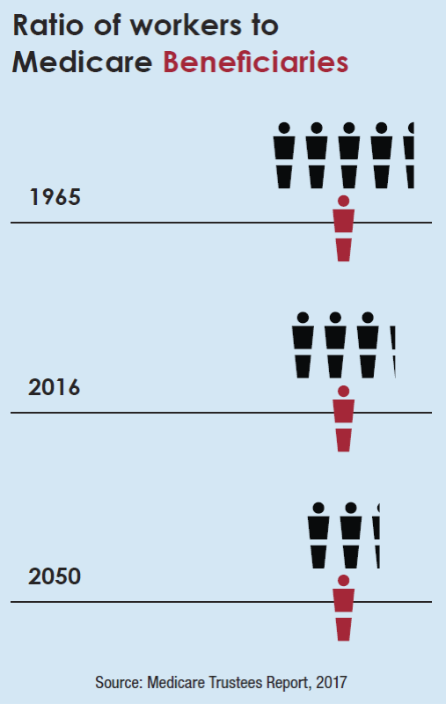
Value and affordability
Our strategy
Public programs: reforms vs. ratcheting
Entitlement reforms
In 1965 life expectancy was:
67 for males
74 for females
Today…life expectancy is:
75 for males
80 for females

Slide 35
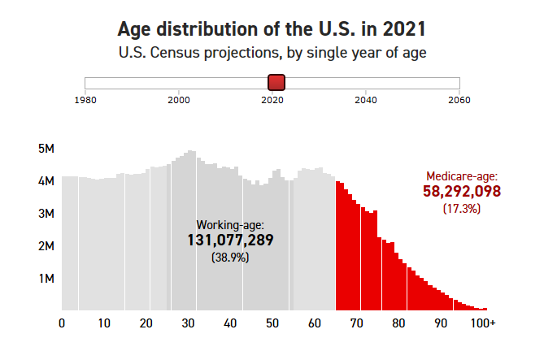

Slide 36
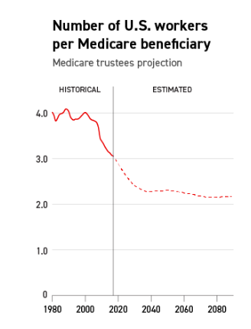

Slide 38
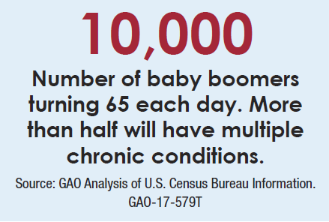

Slide 39
The average Medicare patient sees seven physicians across four different practices
“Bright Spots in Care Management in Medi- care Advantage,” Robert Graham Center Pol- icy Studies in Family Medicine and Primary Care,” June 2017
75% of those who are admitted
to the hospital cannot identify the clinician responsible for their care.
20% of Medicare fee-for-service patients who are discharged from the hospital are readmitted within 30 days.
The average primary care physician interacts with 229 physicians at 117 different practices for Medicare patients.
Health service delivery fragmentation costs $130 billion annually.

Slide 40
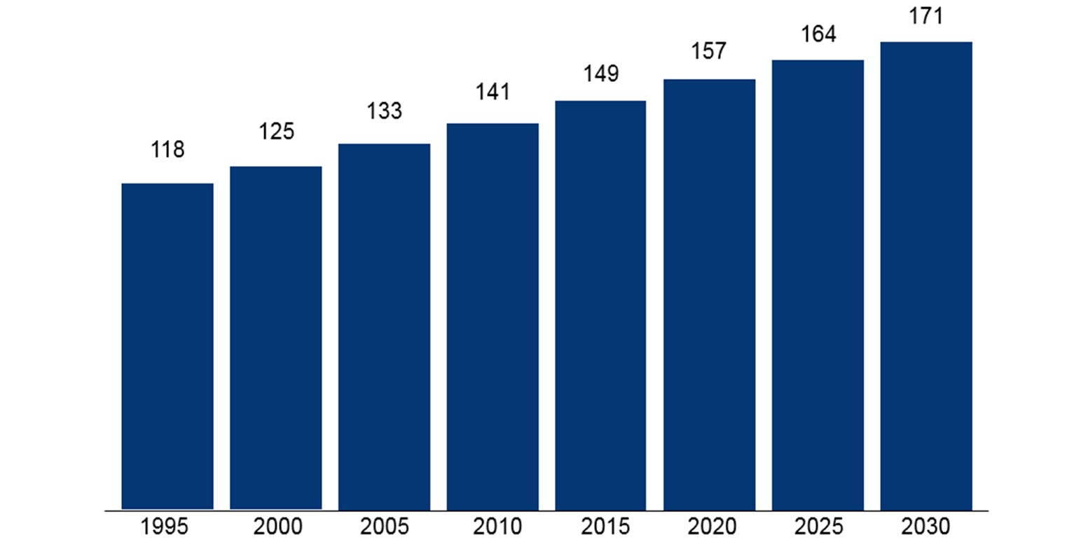
Source: Robert Woods Johnson Foundation. Chronic care: making the case for ongoing care. February 2010.

Slide 41
Chronic diseases are driving up health care spending
86%
Diabetes
54.9 million people will have diabetes in the U.S. in the year 2030, compared with 35.6 million in 2015. This
represents a 54% increase.
Diabetes will cost the nation more than $622 billion in 2030, up from roughly $408 billion in 2015.**
Alzheimer’s disease
of the nation’s health care
spending is for patients with one or more chronic condi- tions.*
The number of Americans 65 or older with Alzheimer’s disease is projected to increase from 5.1 million in 2015 to 13.5 million in 2050.
The cost of care will rise from $113 billion in 2015 to $589 billion in 2050, and will rep- resent nearly one in three Medicare dollars.***
* “Multiple Chronic Conditions Chartbook: 2010 Medical Expenditure Panel Survey Data,” Jessie Gerteis, MPH et al., Agency for Healthcare Research and Quality, April 2014
** “Diabetes 2030: Insights from Yesterday, Today, and Future Trends,” William R. Rowley, M.D., et al., Population Health Management, Feb. 1, 2017
*** Changing the Trajectory of Alzheimer’s Disease: How a Treatment by 2025 Saves Lives and Dollars,” Alzheimer’s Association, 2015

Slide 42
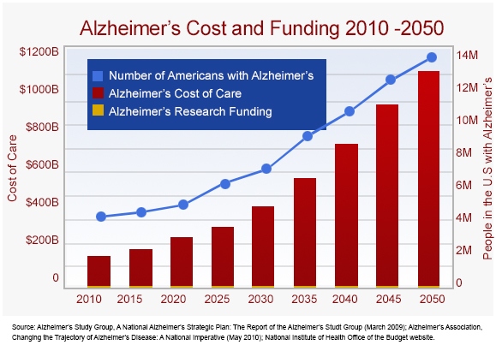

Slide 43
Value and affordability
Business
Individuals
Government pressures
Competing priorities

Slide 44
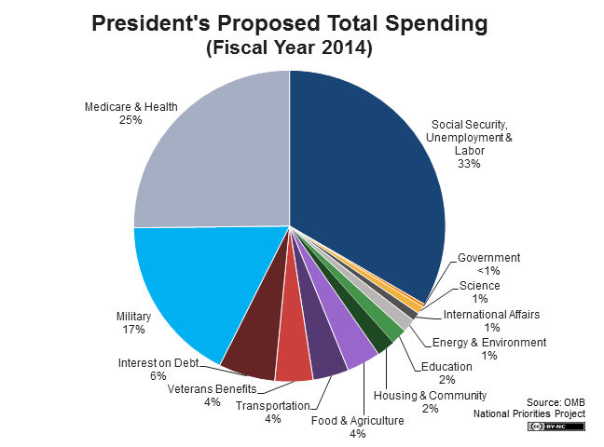
Federal budget challenge
Medicare and Medicaid always in the middle of federal budget discussions

Slide 45
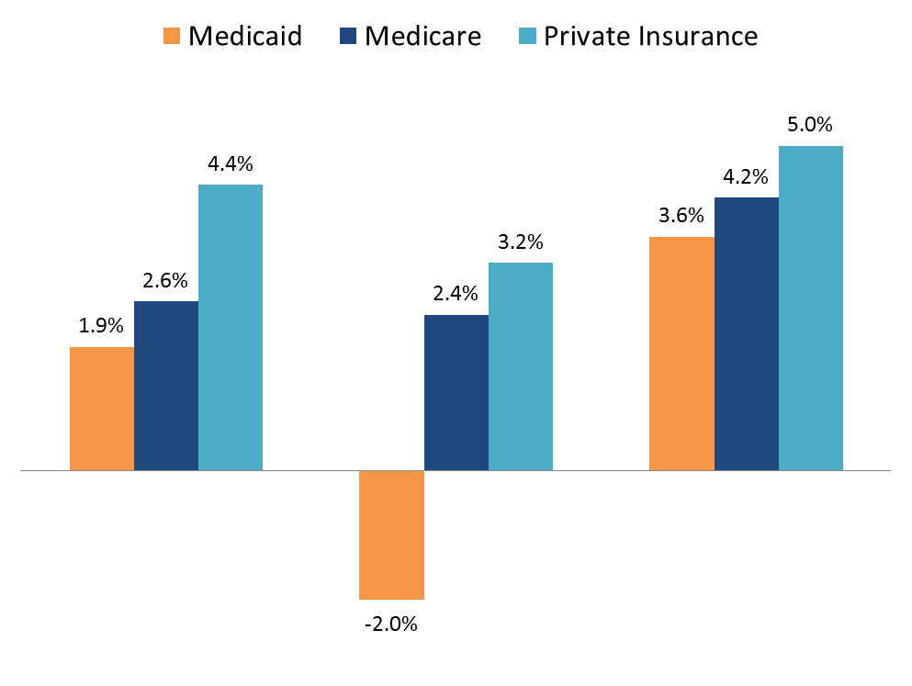
Medicaid Per Enrollee Spending Growth Lower Than Other Payers
Average Annual Growth in Per Enrollee Spending
1
2006 - 2013
2013 - 2014
2014 - 2023
Source: MACPAC, “Trends in Hospital Spending” Available at: https://www.macpac.gov/wp-content/uploads/2016/06/Trends-in-Medicaid-Spending.pdf.
1. MACPAC reported a range of 2.0-6.0%.

Slide 46
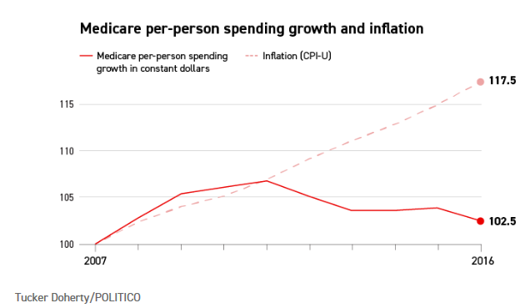
Average Annual Growth in Per Enrollee Spending

Slide 47
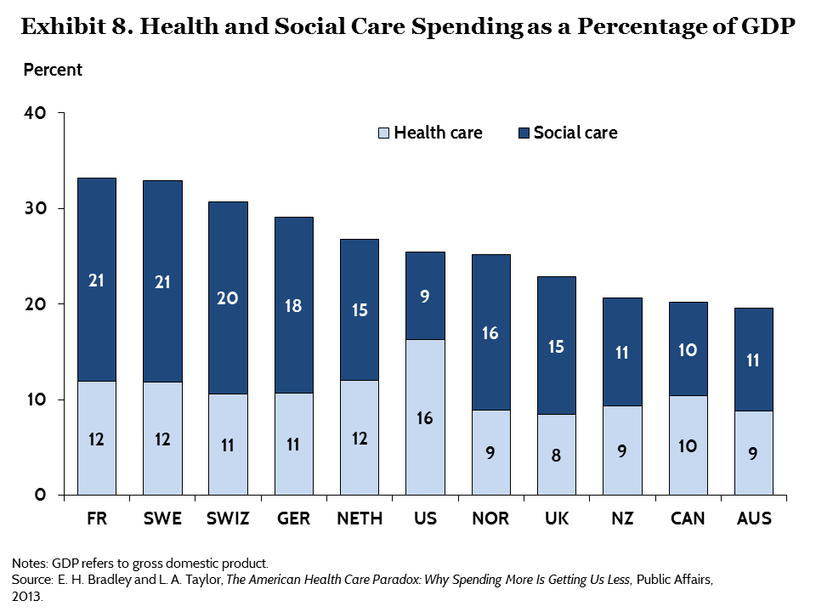
United States spends much less on social programs like retirement benefits, disability benefits, employment programs, and housing when compared to other high income nations.

Slide 49
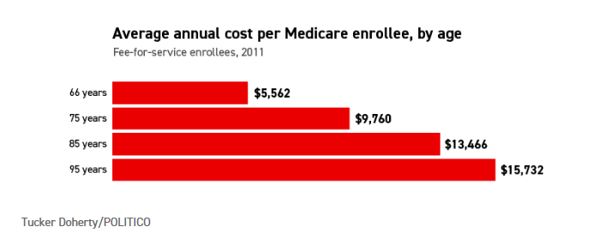

Slide 50
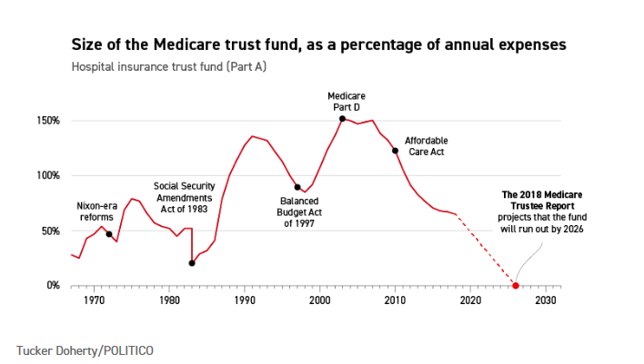

Slide 51
