Slide 1
Healthcare Community
Development Group
New Markets Tax Credits 101
January 2019

Slide 2
NMTC Overview
New Market Tax Credits
When and how can they be used?
How are these transactions structured?
Risks and Rewards
What are the common deal issues?
Roles and Responsibilities
Investors
Community Development Entity
Leverage Lenders
Qualified Active Low-Income Community Business
Consultants and Advisors

Slide 3
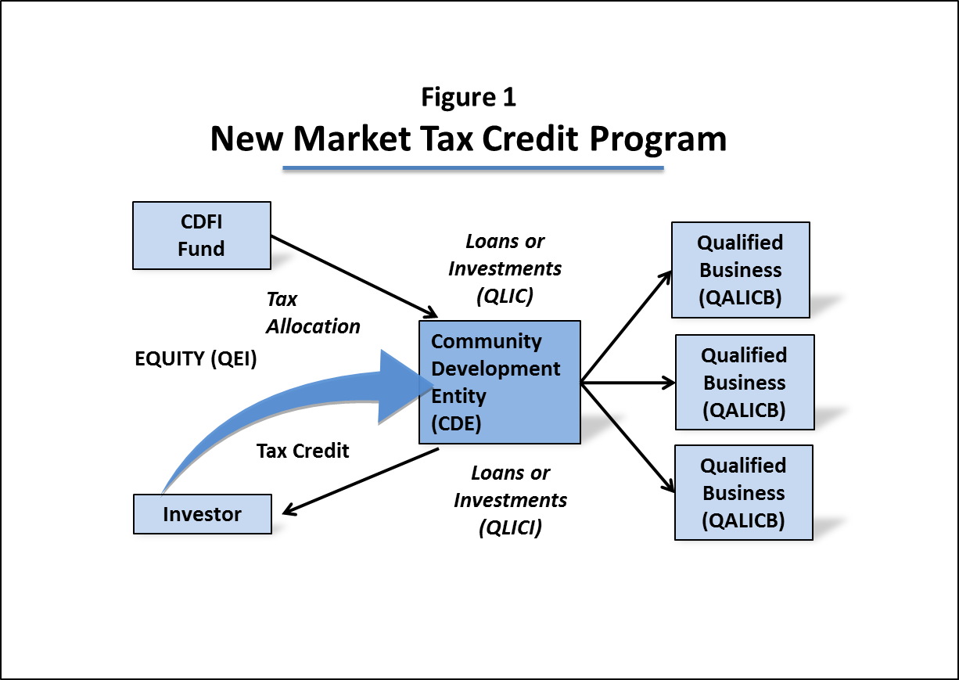
New Markets Tax Credits
NMTC are a financing source for compelling projects in low income communities toward improving their economic climate, (hence the name “New Markets”);
NMTC enable projects to achieve their financing requirements rather than suffer from financing shortfalls;
NMTC debt is structured with a below-market interest rate, the principal for which is effectively forgiven upon maturity;
NMTC for hospitals typically target projects with total budgets in the $10MM to $25MM range;
NMTC generally provide some net 15% to 20% of total project budget financing.
Example: A hospital seeks $20MM in financing for operating rooms construction for which $16MM in financing has been apportioned leaving a $4MM funding gap, in turn filled by NMTC proceeds.

Slide 4
Impact of Investment
Finances projects which traditional banking channels won’t, while creating jobs, facilitating the delivery of social services and driving private investment into low-income communities
Between 2003 and 2012, NMTC Financing created over 750,000 jobs in economically distressed communities across America
NMTC Investments between 2003 and 2010 generated over $5.3 billion in federal tax and over $3 billion in state and local tax revenue

